Slide 1



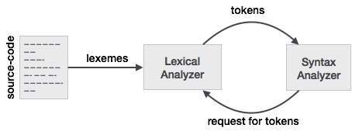
Regular Expression and Grammar
Lexical analysis is the first phase of a compiler. It takes the modified source code from language
preprocessors that are written in the form of sentences.
The lexical analyzer breaks these syntaxes into a series of tokens, by removing any whitespace
or comments in the source code. If the lexical analyzer finds a token invalid, it generates an error.
The lexical analyzer works closely with the syntax analyzer. It reads character streams from the source code, checks for legal tokens, and passes the data to the syntax analyzer when it demands.

Slide 2
Tokens
Lexemes are said to be a sequence of characters (alphanumeric) in a token. There are some predefined rules for every lexeme to be identified as a valid token. These rules are defined by grammar rules, by means of a pattern. A pattern explains what can be a token, and these patterns are defined by means of regular expressions.
In programming language, keywords, constants, identifiers, strings, numbers, operators and punctuations symbols can be considered as tokens.
For example, in C language, the variable declaration line
int value = 100;
contains the tokens:
int (keyword), value (identifier), = (operator), 100 (constant) and ; (symbol).

Slide 3
Specifications of Tokens
Let us understand how the language theory undertakes the following terms:
Alphabets
Any finite set of symbols {0,1} is a set of binary alphabets, {0,1,2,3,4,5,6,7,8,9,A,B,C,D,E,F} is a set of Hexadecimal alphabets, {a-z, A-Z} is a set of English language alphabets.
Strings
Any finite sequence of alphabets is called a string. Length of the string is the total number of occurrence of alphabets, e.g., the length of the string Compiler is 8 and is denoted by |Compiler| = 8. A string having no alphabets, i.e. a string of zero length is known as an empty string and is denoted by ε (epsilon).

Slide 4
Special Symbols
A typical high-level language contains the following symbols:-
Arithmetic Symbols | Addition(+), Subtraction(-), Modulo(%), Multiplication(*), Division(/)
Punctuation | Comma(,), Semicolon(;), Dot(.), Arrow(->)
Assignment | =
Special Assignment | +=, /=, *=, -=
Comparison | ==, !=, <, <=, >, >=
Preprocessor | #
Location Specifier | &
Logical | &, &&, |, ||, !
Shift Operator | >>, >>>, <<, <<<

Slide 5
Language:
A language is considered as a finite set of strings over some finite set of alphabets. Computer languages are considered as finite sets, and mathematically set operations can be performed on them. Finite languages can be described by means of regular expressions.
Longest Match Rule
When the lexical analyzer read the source-code, it scans the code letter by letter; and when it encounters a whitespace, operator symbol, or special symbols, it decides that a word is completed.

Slide 6
For example:
int intvalue;
While scanning both lexemes till ‘int’, the lexical analyzer cannot determine whether it is a keyword int or the initials of identifier int value.
The Longest Match Rule states that the lexeme scanned should be determined based on the longest match among all the tokens available.
The lexical analyzer also follows rule priority where a reserved word, e.g., a keyword, of a language is given priority over user input. That is, if the lexical analyzer finds a lexeme that matches with any existing reserved word, it should generate an error.

Slide 7
The lexical analyzer needs to scan and identify only a finite set of valid string/token/lexeme that belong to the language in hand. It searches for the pattern defined by the language rules
Regular expressions have the capability to express finite languages by defining a pattern for finite strings of symbols. The grammar defined by regular expressions is known as regular grammar. The language defined by regular grammar is known as regular language.
Regular expression is an important notation for specifying patterns. Each pattern matches a set of strings, so regular expressions serve as names for a set of strings. Programming language tokens can be described by regular languages. The specification of regular expressions is an example of a recursive definition. Regular languages are easy to understand and have efficient implementation.
There are a number of algebraic laws that are obeyed by regular expressions, which can be used to manipulate regular expressions into equivalent forms.

Slide 8
Operations:
The various operations on languages are:
Union of two languages L and M is written as
L U M = {s | s is in L or s is in M}
Concatenation of two languages L and M is written as
LM = {st | s is in L and t is in M}
The Kleene Closure of a language L is written as
L* = Zero or more occurrence of language L.

Slide 9
Notations:
If r and s are regular expressions denoting the languages L(r) and L(s), then
Union : (r)|(s) is a regular expression denoting L(r) U L(s)
Concatenation : (r)(s) is a regular expression denoting L(r)L(s)
Kleene closure : (r)* is a regular expression denoting (L(r))*
(r) is a regular expression denoting L(r)

Slide 10
Precedence and Associativity
*, concatenation (.), and | (pipe sign) are left associative
* has the highest precedence
Concatenation (.) has the second highest precedence.
| (pipe sign) has the lowest precedence of all.

Slide 11
Representing valid tokens of a language in regular expression
If x is a regular expression, then:
x* means zero or more occurrence of x.
i.e., it can generate { e, x, xx, xxx, xxxx, … }
x+ means one or more occurrence of x.
i.e., it can generate { x, xx, xxx, xxxx … } or x.x*
x? means at most one occurrence of x
i.e., it can generate either {x} or {e}.
[a-z] is all lower-case alphabets of English language.
[A-Z] is all upper-case alphabets of English language.
[0-9] is all natural digits used in mathematics.

Slide 12
Representing occurrence of symbols using regular expressions
letter = [a – z] or [A – Z]
digit = 0 | 1 | 2 | 3 | 4 | 5 | 6 | 7 | 8 | 9 or [0-9]
sign = [ + | - ]
Representing language tokens using regular expressions
Decimal = (sign)?(digit)⁺
Identifier = (letter)(letter | digit)*

Slide 13
The only problem left with the lexical analyzer is how to verify the validity of a regular expression used in specifying the patterns of keywords of a language. A well-accepted solution is to use finite automata for verification.

Slide 14
Syntax analysis or parsing is the second phase of a compiler. In this chapter, we shall learn the basic concepts used in the construction of a parser.
We have seen that a lexical analyzer can identify tokens with the help of regular expressions and pattern rules. But a lexical analyzer cannot check the syntax of a given sentence due to the limitations of the regular expressions.
Regular expressions cannot check balancing tokens, such as parenthesis. Therefore, this phase uses context-free grammar (CFG), which is recognized by push-down automata.

Slide 15
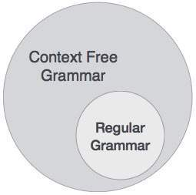
CFG, on the other hand, is a superset of Regular Grammar, as depicted below:
It implies that every Regular Grammar is also context-free, but there exists some problems, which are beyond the scope of Regular Grammar. CFG is a helpful tool in describing the syntax of programming languages.

Slide 16
Context-Free Grammar:
A context-free grammar has four components:
A set of non-terminals (V). Non-terminals are syntactic variables that denote sets of strings. The non-terminals define sets of strings that help define the language generated by the grammar.
A set of tokens, known as terminal symbols (Σ). Terminals are the basic symbols from which strings are formed.
A set of productions (P). The productions of a grammar specify the manner in which the terminals and non-terminals can be combined to form strings. Each production consists of a non-terminal called the left side of the production, an arrow, and a sequence of tokens and/or on- terminals, called the right side of the production.
One of the non-terminals is designated as the start symbol (S); from where the production begins.
The strings are derived from the start symbol by repeatedly replacing a non-terminal (initially the start symbol) by the right side of a production, for that non-terminal.

Slide 17
Example
We take the problem of palindrome language, which cannot be described by means of Regular Expression.
That is, L = { w | w = w^{R} } is not a regular language. But it can be described by means of CFG, as illustrated below:
G = ( V, Σ, P, S )
Where:
V = { Q, Z, N }
Σ = { 0, 1 }
P = { Q → Z | Q → N | Q → ℇ | Z → 0Q0 | N → 1Q1 }
S = { Q }
This grammar describes palindrome language, such as: 1001, 11100111, 00100, 1010101, 11111, etc.

Slide 18
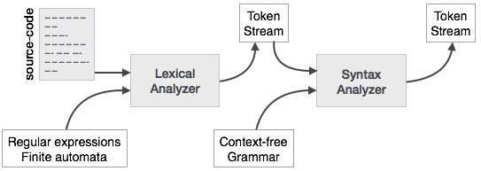
Syntax Analyzers
A syntax analyzer or parser takes the input from a lexical analyzer in the form of token streams. The parser analyzes the source code (token stream) against the production rules to detect any errors in the code. The output of this phase is a parse tree.
This way, the parser accomplishes two tasks, i.e., parsing the code, looking for errors and generating a parse tree as the output of the phase.
Parsers are expected to parse the whole code even if some errors exist in the program. Parsers use error recovering strategies

Slide 19
Derivation
A derivation is basically a sequence of production rules, in order to get the input string. During parsing, we take two decisions for some sentential form of input:
Deciding the non-terminal which is to be replaced.
Deciding the production rule, by which, the non-terminal will be replaced.
To decide which non-terminal to be replaced with production rule, we can have two options.
Left-most Derivation: If the sentential form of an input is scanned and replaced from left to right, it is called left-most derivation. The sentential form derived by the left-most derivation is called the left-sentential form.
Right-most Derivation: If we scan and replace the input with production rules, from right to left, it is known as right-most derivation. The sentential form derived from the right-most derivation is called the right-sentential form.

Slide 20
Example
Production rules:
E → E + E
E → E * E
E → id
Input string: id + id * id
The left-most derivation is:
E → E * E
E → E + E * E
E → id + E * E
E → id + id * E
E → id + id * id
Notice that the left-most side non-terminal is always processed first.

Slide 21
The right-most derivation is:
E → E + E
E → E + E * E
E → E + E * id
E → E + id * id
E → id + id * id

Slide 22
Parse Tree
A parse tree is a graphical depiction of a derivation. It is convenient to see how strings are derived from the start symbol. The start symbol of the derivation becomes the root of the parse tree. Let us see this by an example from the last topic.
We take the left-most derivation of a + b * c
The left-most derivation is:
E → E * E
E → E + E * E
E → id + E * E
E → id + id * E
E → id + id * id

Slide 23
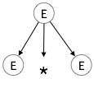
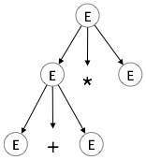
Step 1:
E → E * E
Step 2:
E → E + E * E

Slide 24
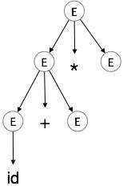
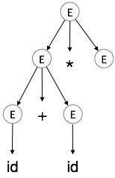
Step 3:
Step 4:
E → id + E * E
E → id + id * E

Slide 25
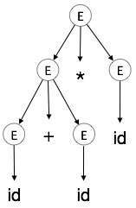
Step 5:
In a parse tree:
All leaf nodes are terminals.
All interior nodes are non-terminals.
In-order traversal gives original input string.
A parse tree depicts associativity and precedence of operators.
The deepest sub-tree is traversed first, therefore the operator in that sub-tree gets precedence over the operator which is in the parent nodes.
E → id + id * id

Slide 26
Thank You

